Slide 1
Departmental INDUCTION
A randomised controlled trial of STeroid Administration Routes For Idiopathic Sudden sensorineural Hearing loss
V1.0, 12-Jun-2023

Slide 2
The starfish trial
Local Principle Investigator:
Local Associate PI:
Funder:
Chief Investigators:
XXX
XXX
National Institute for Health and Care Research (NIHR)
Matthew Smith and James Tysome
These slides are designed to help the local PI and aPI introduce the trial to the local department
A separate, more detailed presentation is provided for those seeking inclusion on the delegation log

Slide 3
Background
Idiopathic sudden sensorineural hearing loss (ISSNHL):
Incidence approximates 5-20 per 100,000
Spontaneous recovery is seen in 32-65% of cases
May go unrecognised or unreferred
Functional and psychological impact on patients can be great
Steroid administration route was a high priority research recommendation from NICE

Slide 4
Trial objectives
Primary Objective:
To establish the relative effects of oral, intratympanic or combined oral and intratympanic steroids on hearing recovery in ISSNHL, when used as first line management
Secondary Objectives:
To complete a health economic assessment of the different routes of steroid administration
To use participant submitted data to explore the trajectory of hearing recovery

Slide 5
Trial design
Population
Interventions
Outcomes
Adults with new-onset ISSNHL
Primary outcome:
Absolute improvement in pure tone audiogram average at 12-weeks following randomisation
Screening
Consent Randomisation
Baseline
assessment
Optional home hearing tests
Follow up at 6 and 12 weeks

Slide 6
Trial design
Population
Interventions
Outcomes
Adults with new-onset ISSNHL
Primary outcome:
Absolute improvement in pure tone audiogram average at 12-weeks following randomisation
Screening
Consent Randomisation
Baseline
assessment
Optional home hearing tests
Follow up at 6 and 12 weeks
This stage needs everyone to help - ensuring patients are identified and not unintentionally excluded by treatment

Slide 7
Eligibility - Inclusion
Diagnosis of new-onset ISSNHL: Sensorineural hearing loss of 30 decibels (dBHL) or greater Occurring within a 3-day period Including 3 contiguous pure-tone frequencies (out of 0.5, 1.0, 2.0, 4.0 kHz) confirmed with a pure tone audiogram
Aged 18 years or over
Onset of hearing loss within four weeks prior to randomisation
English spoken as a first or second language
Exclusion criteria are in Protocol
PLEASE IDENTIFY THESE PATIENTS AT THE POINT OF REFERRAL
The local trial team will then screen the patient for suitability
Notes:
NB – this is a summary of key eligibility, see the Protocol for the full list.

Slide 8
Patient information
Potentially eligible participants will be approached by a member of the local STARFISH trial team
A STARFISH Patient Information Sheet will be given to the patient
Patients can be directed to the patient information video on the website: www.birmingham.ac.uk/STARFISH

Slide 9
INTERVENTIONS
Trial participants will be randomised in 1:1:1 ratio to:
Arm 1
Oral steroid
Arm 2
Intratympanic steroid
Arm 3
Combined oral and intratympanic steroid
OR
OR
The normal prescribing process and standard pharmacy stock will be used, though must be prescribed by the local trial team.

Slide 10
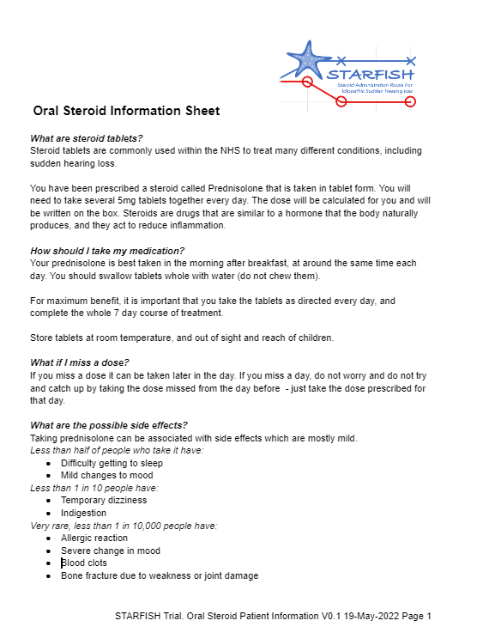
INTERVENTIONS
Oral Steroid:
7 day course
Prednisolone 1mg/kg/day (rounded to 5mg) to a maximum dose of 60mg
Standard outpatient or FP10 prescription
Participants receive an Oral Steroid Information Sheet

Slide 11
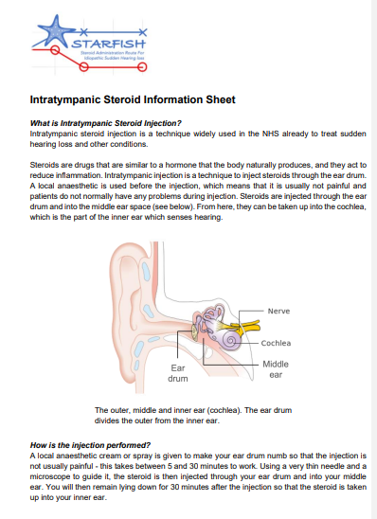
INTERVENTIONS
Intratympanic Steroid:
3 injections spaced 7±2 days apart
Dexamethasone 3.3 or 3.8mg/ml
Standard clinical technique as per online video
Local anaesthetic according to local practice
If recovery to near to normal hearing occurs:
Discuss with the patient
May omit injections 2 and/or 3
Participants receive an Intratympanic Steroid Information Sheet
Please ensure dexamethasone for injection is available out-of-hours

Slide 12
Timing of treatment
Starting steroid treatment
Meta analysis supports limited or no impact of delayed steroid treatment on SSNHL final hearing outcomes (Liebau et al. 2017)
STARFISH requires patients not to be prior-treated with steroid by primary care, ED or by ENT
Participant randomisation and steroid treatment can be delayed until relevant staff or facilities are available e.g. from Saturday to Monday
In the combined treatment arm, intratympanic steroid can be delayed and given any time within four days of starting oral steroids
Liebau et al. Hearing Changes After Intratympanically Applied Steroids for Primary Therapy of Sudden Hearing Loss: A Meta-analysis Using Mathematical Simulations of Drug Delivery Protocols.
Otol Neurotol. 2017 Jan;38(1):19-30. doi: 10.1097/MAO.0000000000001254.

Slide 13
OUTCOMES – CLINICAL ASSESSMENTS
Otoscopy
Pure tone audiometry
AB phoneme speech audiometry
*There is some flexibility in timing for this outcome; where essential, baseline measurement can be delayed up to 48hrs after treatment
Recorded at baseline, 6 weeks and 12 weeks

Slide 14
OUTCOMES – PATIENT BOOKLET
Speech, Spatial and Qualities of hearing scale (SSQ)
Vestibular Rehab. Benefit Questionnaire (VRBQ)
Tinnitus Functional Index (TFI)
Health Utilities Index 3 (HUI3) and ‘ICECAP-A’ questionnaires
Recorded at baseline, 6 weeks and 12 weeks
Questionnaire booklet completed on paper, in clinic, checked by local trial team, then returned to the trials unit in pre-payed envelope
Notes:
Nb – questionnaire outcomes selected based on patient feedback on what was most relevant and meaningful for them.

Slide 15
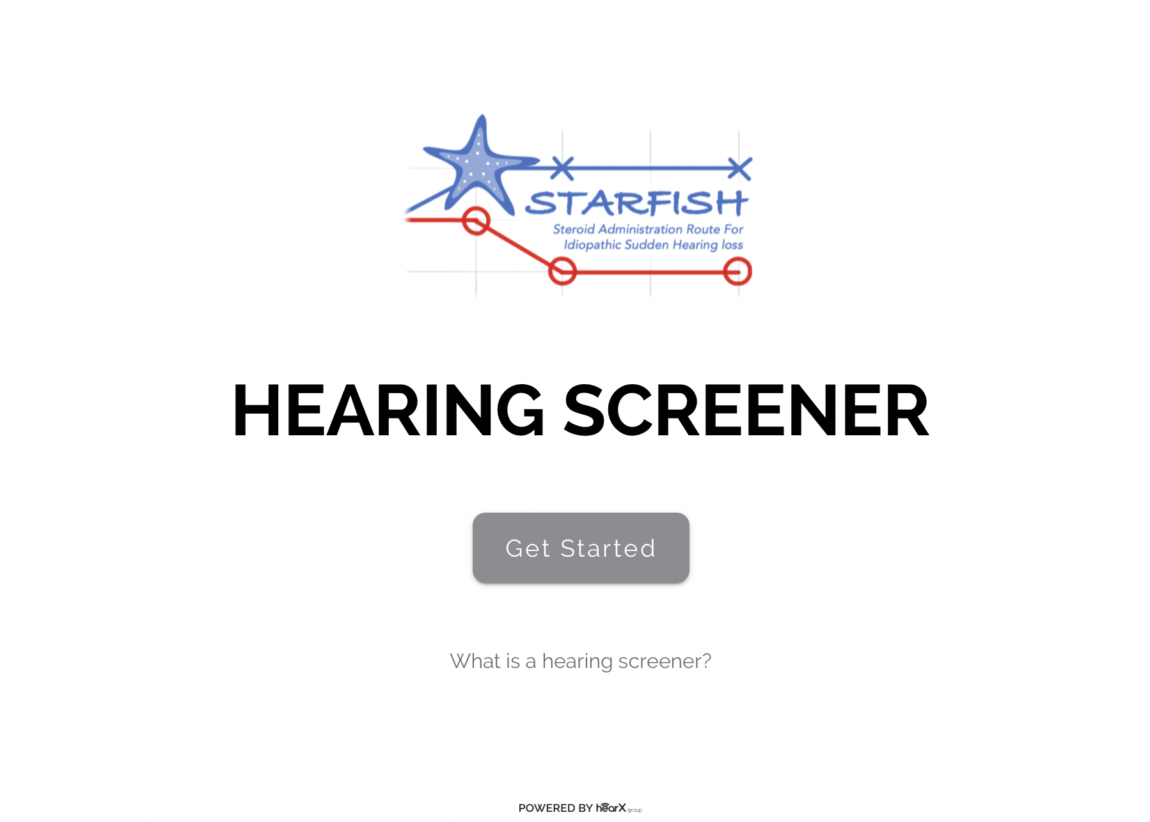
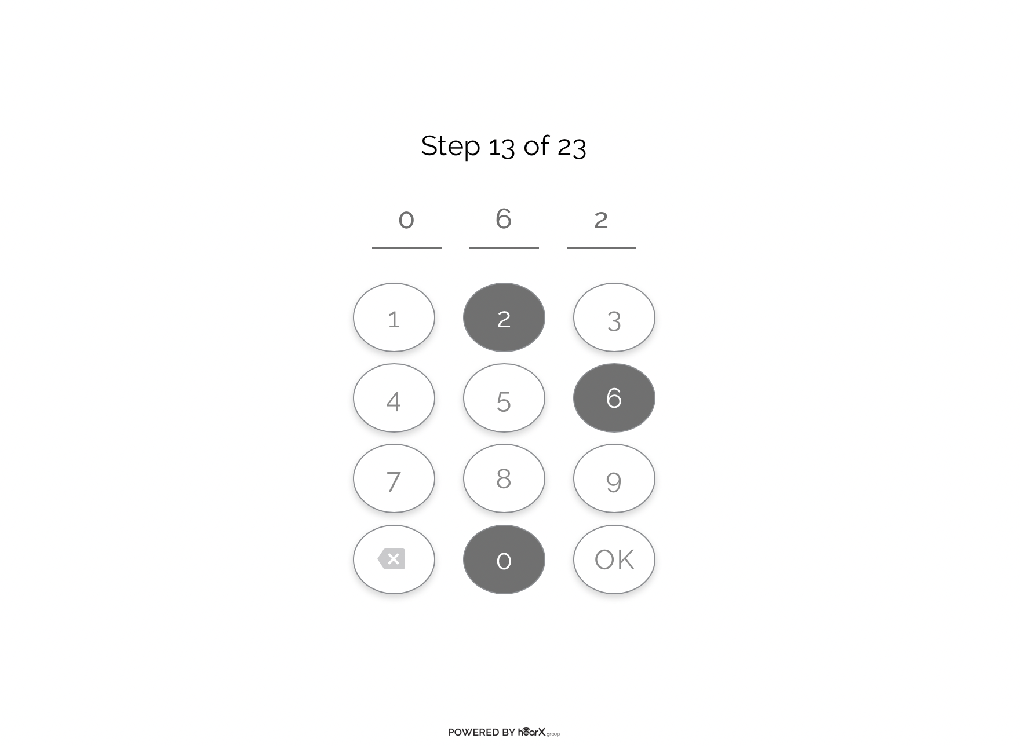
HOME HEARING TESTS
Optional home hearing tests for participants
To define the trajectory of hearing recovery
Strongly supported by our patient group
Completed via the trial website every week, for 12 weeks:
Digits-in-noise
Pure tone audiogram tests (TBC)
Consenting participants will be supplied with earphones
Weekly text message prompts will be sent, including the participant ID

Slide 16
ASSOCIATE PI SCHEME
Trainees can choose to be NIHR Associate PIs
In-work training opportunity
A chance to experience what it means to work on and deliver a NIHR portfolio trial
6 month+ involvement required (this can be at more than one site after rotation)
Local PI acts as a mentor
Online training activities on NIHR Learn
Formal certification
Recognised by RCS and all colleges
Notes:
MS

Slide 17
Key Points for a successful trial site
All ENT doctors, audiologists and nurses can help make trial recruitment a success:
Ensure potentially eligible participants are passed on to local trial collaborators
Do not advise GPs to start steroids prior to hospital review
If you can, engage your GP colleagues so they are aware of SSNHL and the need to refer urgently for assessment before starting treatment
Engage your audiology colleagues, particularly regarding AB testing
Ensure that awareness of the STARFISH trial is included in junior doctor handover: at FY, CT and ST level
Use the video training material provided for intratympanic injection and AB speech testing
Get in touch with the central STARFISH trial team if you have any problems

Slide 18
Find out more
INTEGRATE: | https://entintegrate.co.uk/starfish
 | STARFISH@trials.bham.ac.uk |  | @STARFISH_trial
 | www.birmingham.ac.uk/starfish |  | www.facebook.com/StarfishTrial

