Slide 1
Measles Update
January 2024

Slide 2
Overview - Current Situation
1
Rise in Cases
There has been a rise in measles cases in England in 2023.
2
Global Increase
Since 2022, global activity has been increasing, with large outbreaks in South Asia and Africa.
3
MMR Coverage Decline
MMR coverage in the UK has fallen to the lowest level in a decade.
4
WHO Call to Action
In Feb 2022, WHO Europe called for urgent action to catch-up on missed MMR vaccine doses.
5
NHS Commitment
Achieving 95% uptake with 2 MMR doses by age 5 is a high priority within NHS England.

Slide 3
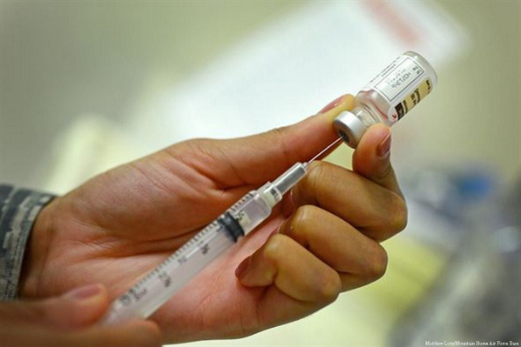
Importance for Primary Care
First Contact
Preventive Setting
Staff Vaccination
Measles cases are most likely to contact primary care first, therefore staff need to be able to:
Identify suspected cases and notify the Health Protection Team (HPT) promptly
Take appropriate action to stop onward transmission without delay and protect vulnerable contacts
Primary care provides the setting to raise awareness and offer vaccination.
To protect staff and prevent transmission of measles in health care settings.
Patient facing staff should have documented evidence of 2 doses of the MMR vaccine or have positive antibody tests for measles and rubella

Slide 4
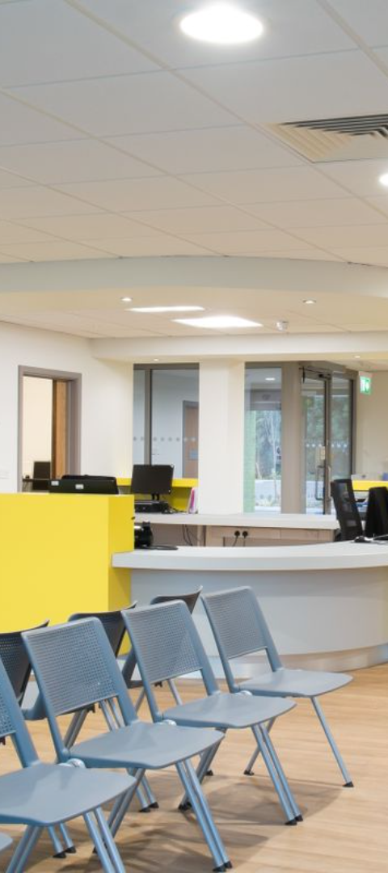
Prevention
Signage
Place signs in reception areas advising patients with rash illnesses to report to staff
Reception Training
Train receptionists to direct potentially infectious patients to telephone triage
In-Person Review
If in-person review is needed, ensure patients are placed in an appropriate location e.g. isolation room. If clinically acceptable, suspected cases should attend at end of day to minimise risk of transmission

Slide 5
MECC and Occupational Health
Make Every Contact Count (MECC)
Vaccine Offer
Offer the vaccine to unvaccinated or partially vaccinated individuals. 2 doses should be given at least 4 weeks apart. It is safe to receive an extra MMR dose
Check immunisation history of every patient, especially children, new registrations, migrants and displaced people
Staff Health
Staff involved in direct patient care should have documented evidence of 2 doses of MMR or have positive antibody tests

Slide 6
National MMR Call and Recall
To support improvements in MMR vaccine uptake there is a planned National MMR Call and Recall this will be delivered during February and March 2024. National MMR call and recall involves sending a MMR vaccination reminder/s to patients registered with a general practice in England or resident in England who are unvaccinated or are partially vaccinated according to NHSE records.
Throughout February (from w/c 05 February) and March 2024, national MMR vaccination reminders will be sent to the parents/guardians of children age 6-11 years. In London and some parts of the West Midlands, NHSE plans to extend the target age cohorts so that children and young adults age 6-25 years will receive MMR vaccination reminders. This is because these regions are at particular risk of measles outbreaks.
General practices are asked to:
Prepare to receive enquiries from their registered patients during February and March 2024 who have received a national MMR vaccination reminder,
Check immunisation records and if required offer vaccination.
Further information on the practice role in support of national MMR call and recall is available in
Annex A here.

Slide 7
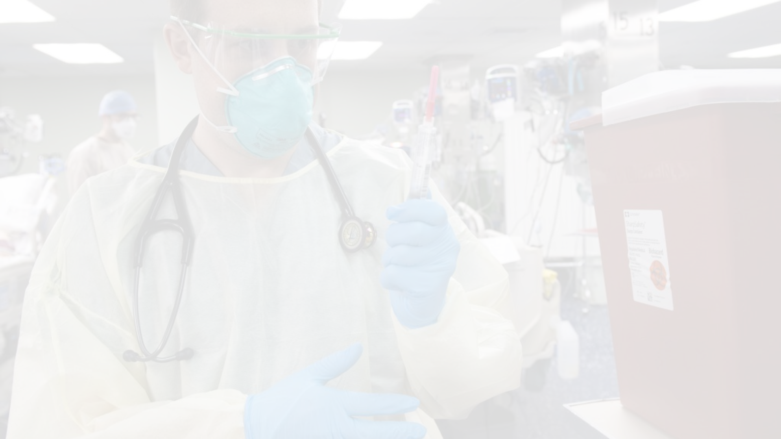
Measles: Key Facts
1
Highly Contagious
2
Transmission
Measles is caused by a virus that spreads very easily
Transmitted through respiratory route or direct contact with secretions
3
Incubation Period
4
Infectious Period
Incubation period: 10 to 12 days from exposure to onset of symptoms
Infectious period: 4 days before to 4 days after onset of rash

Slide 8
Clinical Presentation: Prodromal Phase
1
Before Rash
2 to 4 days before the rash appears: high fever, cough, runny/stuffy nose, sneezing and sore red eyes that are sensitive to light (conjunctivitis)
2
Fever Peak
Fever typically increases to peak around rash onset

Slide 9
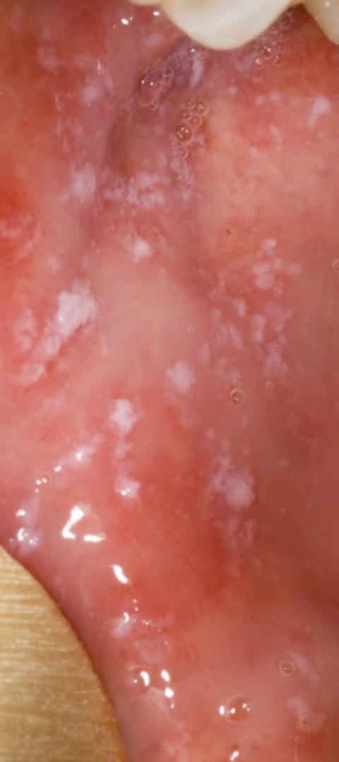
Clinical Presentation: Koplik Spots
Koplik Spots
Prodromal Phase
Koplik spots are small white/bluish spots inside cheeks/back of the lips.
Characteristic of the prodromal phase, appearing 1 to 4 days before the rash.
Spot Disappearance
Usually disappear on day 2 of the rash, so may not be present when case presents.

Slide 10
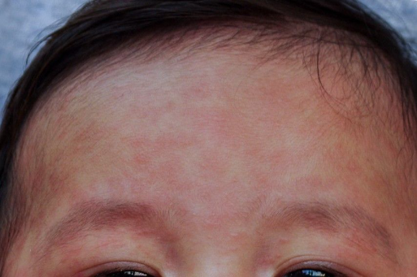
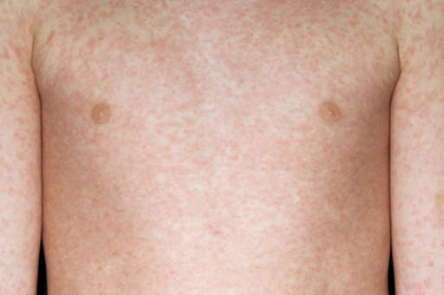
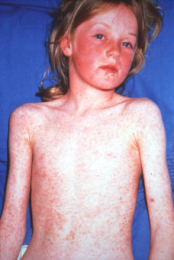
Clinical Presentation: Rash
Rash Onset
Rash Characteristics
Rash Duration
Usually starts on the face, spreading to trunk and rest of the body.
Red/brown spots, flat or maculopapular, increase over 2 to 3 days.
Generally lasts for 3 to 7 days, more difficult to spot on dark skin.

Slide 11
Complications of Measles
Otitis Media
7 to 9% of cases
Diarrhoea
8%
Pneumonia
1 to 6%
Convulsions
0.5%
Encephalitis
1 to 4 per 1,000 to 2,000 cases
SSPE (subacute sclerosing pan-encephalitis)
In <2 year olds 1 in 8,000 cases
Pregnancy Risks
Miscarriage, stillbirth, premature birth, or low birth weight

Slide 12
Risk Assessment of Cases
Vaccination Status
Exposure
Travel History
Check vaccination status
Recent exposure to someone with rash/illness
Recent travel
Healthcare Worker
Vulnerable Contacts
Is this person a healthcare worker (HCW)
Any contacts who are immunocompromised or vulnerable

Slide 13
Reporting
1
Urgent Reporting
2
Testing and Advice
Report all suspected cases urgently via phone to your local Health Protection Team (HPT).
0300 303 8162
swhpt@ukhsa.gov.uk
https://www.gov.uk/health-protection-team
The HPT will conduct a risk assessment, provide advice regards testing and organise transport for urgent specimen collection if required. Advice on public health action and contact tracing will also be provided.
3
Hospital Referral
4
Exclusion
Suspected measles cases should only be referred to hospital if clinically indicated. Where admission is planned, contact the local hospital regarding appropriate isolation before admission
Exclude suspected cases from nursery/educational setting/work until 4 days after onset of rash

Slide 14
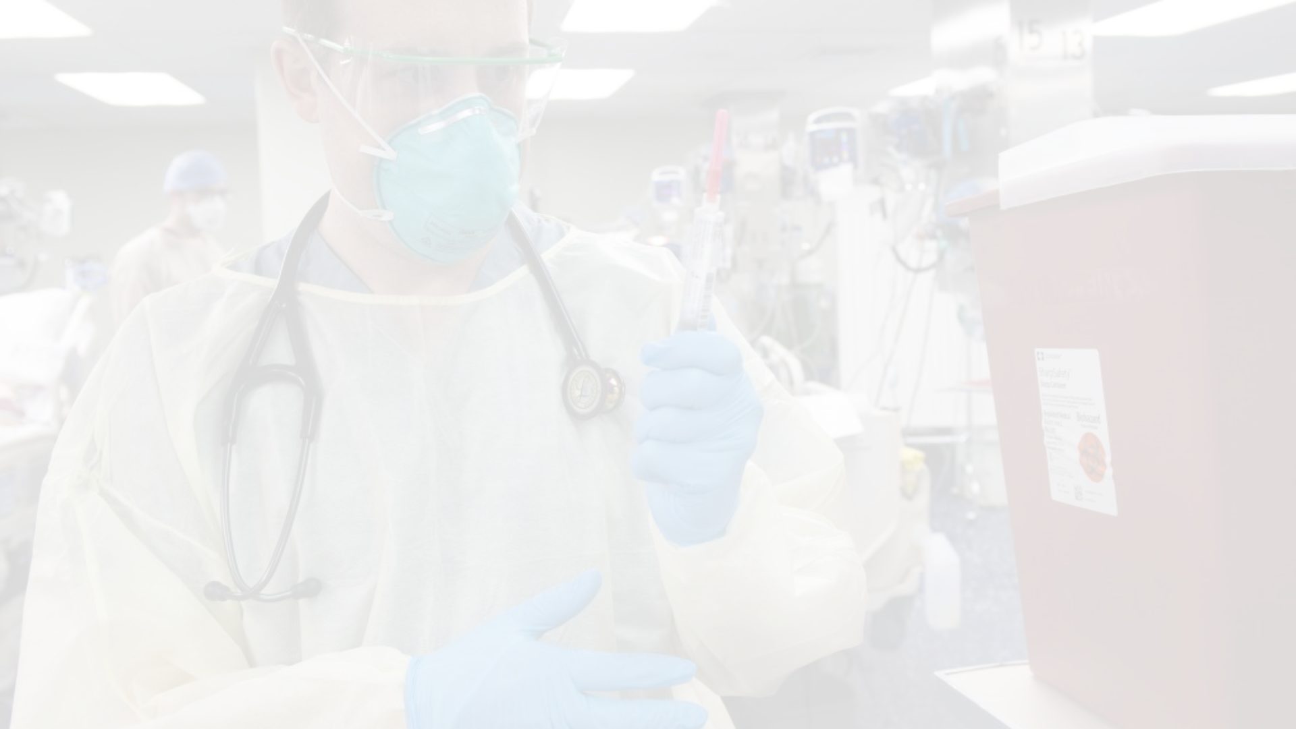
Testing
Direct potentially infectious patients to telephone triage and consultation. If in-person review is required, place patients in an appropriate location, such as an isolation room. If clinically acceptable, schedule suspected cases requiring a face-to-face appointment at the end of the day to minimise transmission risks.
For telephonically triaged patients:
If in-person review is required:
If a patient is suspected of measles during telephone triage, notify HPT without delay and advise the patient to isolate. HPT will assess the situation and provide advice regarding testing, which may include self-testing at home or later attendance at the GP surgery.
For cases requiring a face-to-face appointment, ensure the use of an isolation room. If appropriate, patients should be seen at the end of the day or clinic session.
If measles is suspected, take a sample using a viral swab (see below).
Transmission-based precautions, including the use of fit tested FFP3 masks, should be initiated.
Health Protection Team (HPT):
0300 303 8162
swhpt@ukhsa.gov.uk
If HPT advises attendance to GP surgery for testing, follow guidance for 'In-Person Review' >

Slide 15
Sample Requirements and Handling
For patients with suspected measles infection, a viral swab is required.
Note: any viral swab may be used for measles PCR testing, including a dry swab. A bacterial swab cannot be used as these contain PCR inhibitors
Before using a swab, double-check the expiry date. Collect a viral swab from the throat or mouth,
ensuring to gather the sample along the gum line and over the tongue.
Provide relevant clinical details, date of onset, exposure to other suspected cases, and vaccination
history and date for accurate testing.
Oral fluid testing kits are not recommended for diagnostic purposes but may be used for surveillance
or contact tracing as advised by HPT

Slide 16
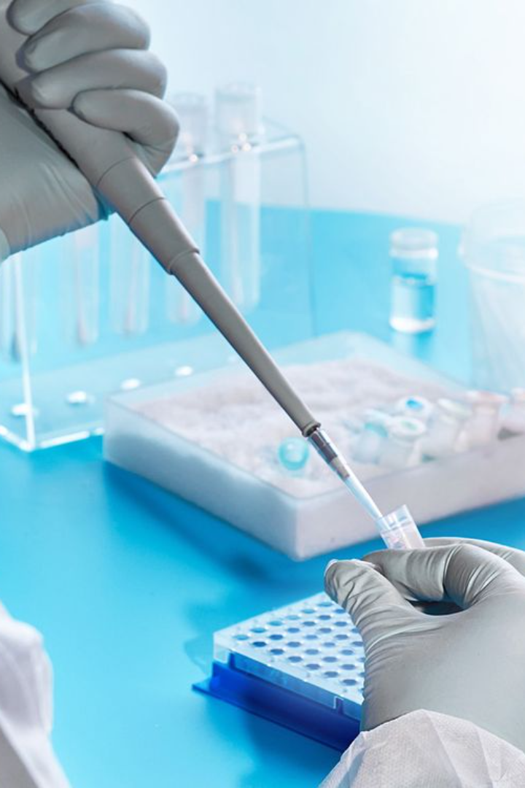
Storage, Transport and Urgent Testing
Store samples at room temperature.
Transport depends on the severity and urgency of the case. Urgent testing is indicated for vulnerable individuals, such as infants, pregnant individuals, and the immunocompromised, who may require immunoglobulin therapy within a 72hr period.
Urgent samples may also be required to identify vulnerable contacts such as unvaccinated children, healthcare workers, and pregnant individuals who may need to be excluded for extended periods.
HPT will advise on the requirement for urgent testing and will organise a courier for such cases. All non-urgent samples can be transported as per normal to the local lab.

Slide 17
Risk Assessment of Contacts
1
Waiting Room Exposure
If the patient was not isolated and exposed other patients, the HPT staff will assist with risk assessment and advise on actions
2
Vulnerable Groups
The most vulnerable groups who may require immunoglobulin are infants, pregnant women, and immunosuppressed individuals
3
Healthcare Worker Exclusion
Health care workers who are not immune will require exclusion from work from days 5 to 21 post exposure
4
HNIG/IVIG
If indicated, immunoglobulin should be given as soon as possible, ideally within 72 hours and up to 6 days after exposure
For further information see: Measles Post-exposure Prophylaxis guidance: https://www.gov.uk/government/publications/measles-post-exposure-prophylaxis

Slide 18
Infection Prevention and Control
1
Standard Infection Control Precautions (SICPs)
2
Transmission Based Precautions (TBPs)
3
Following suspected/confirmed patient vacation of the care area
SICPs must be used by all healthcare workers at all times and in all settings. Comprehensive guidance and advice, including PPE, is available in the National Infection Prevention & Control Manual (NIPCM)
TBPs must be followed in addition to SICPs when caring for a laboratory-confirmed or suspected case of measles. More information can be found in NHS England » Chapter 2: Transmission based precautions (TBPs) and appendix 11a of the NIPCM
Allow sufficient time for clearance of infectious particles before cleaning. Rooms/areas must be cleaned from highest to lowest points and from least to most contaminated points ensuring local policies are followed at all times

Slide 19
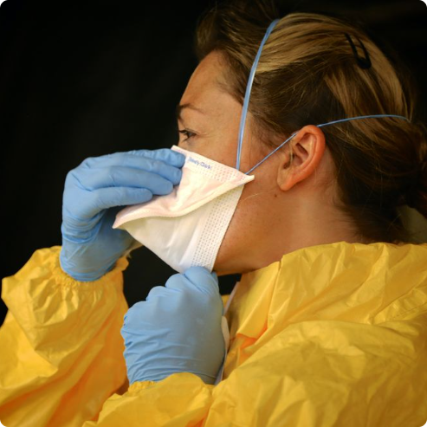
Preventing Transmission
Hand Hygiene
Cough Etiquette
PPE
Proper hand hygiene, including frequent handwashing with soap and water, is essential to prevent the spread of measles
Encourage individuals to cover their mouth and nose with a tissue or their elbow when coughing or sneezing to prevent the spread of droplets
Healthcare workers should use personal protective equipment (PPE) such as gloves, fit tested FFP3 masks, and gowns when caring for patients with measles
Please follow link for specific guidance NHS England » Chapter 2: Transmission based precautions (TBPs)

Slide 20
Key Actions
Direct to telephone triage / Isolation
Reporting
Direct to telephone consultation or cohort/isolate patients presenting with a rash and a fever on arrival
Report suspected cases urgently by phone to your local HPT
MECC
Staff Vaccination
Make Every Contact Count - check immunisation status of every patient
Staff involved in direct patient care should have documented evidence of MMR vaccination or have a positive antibody test

Slide 21
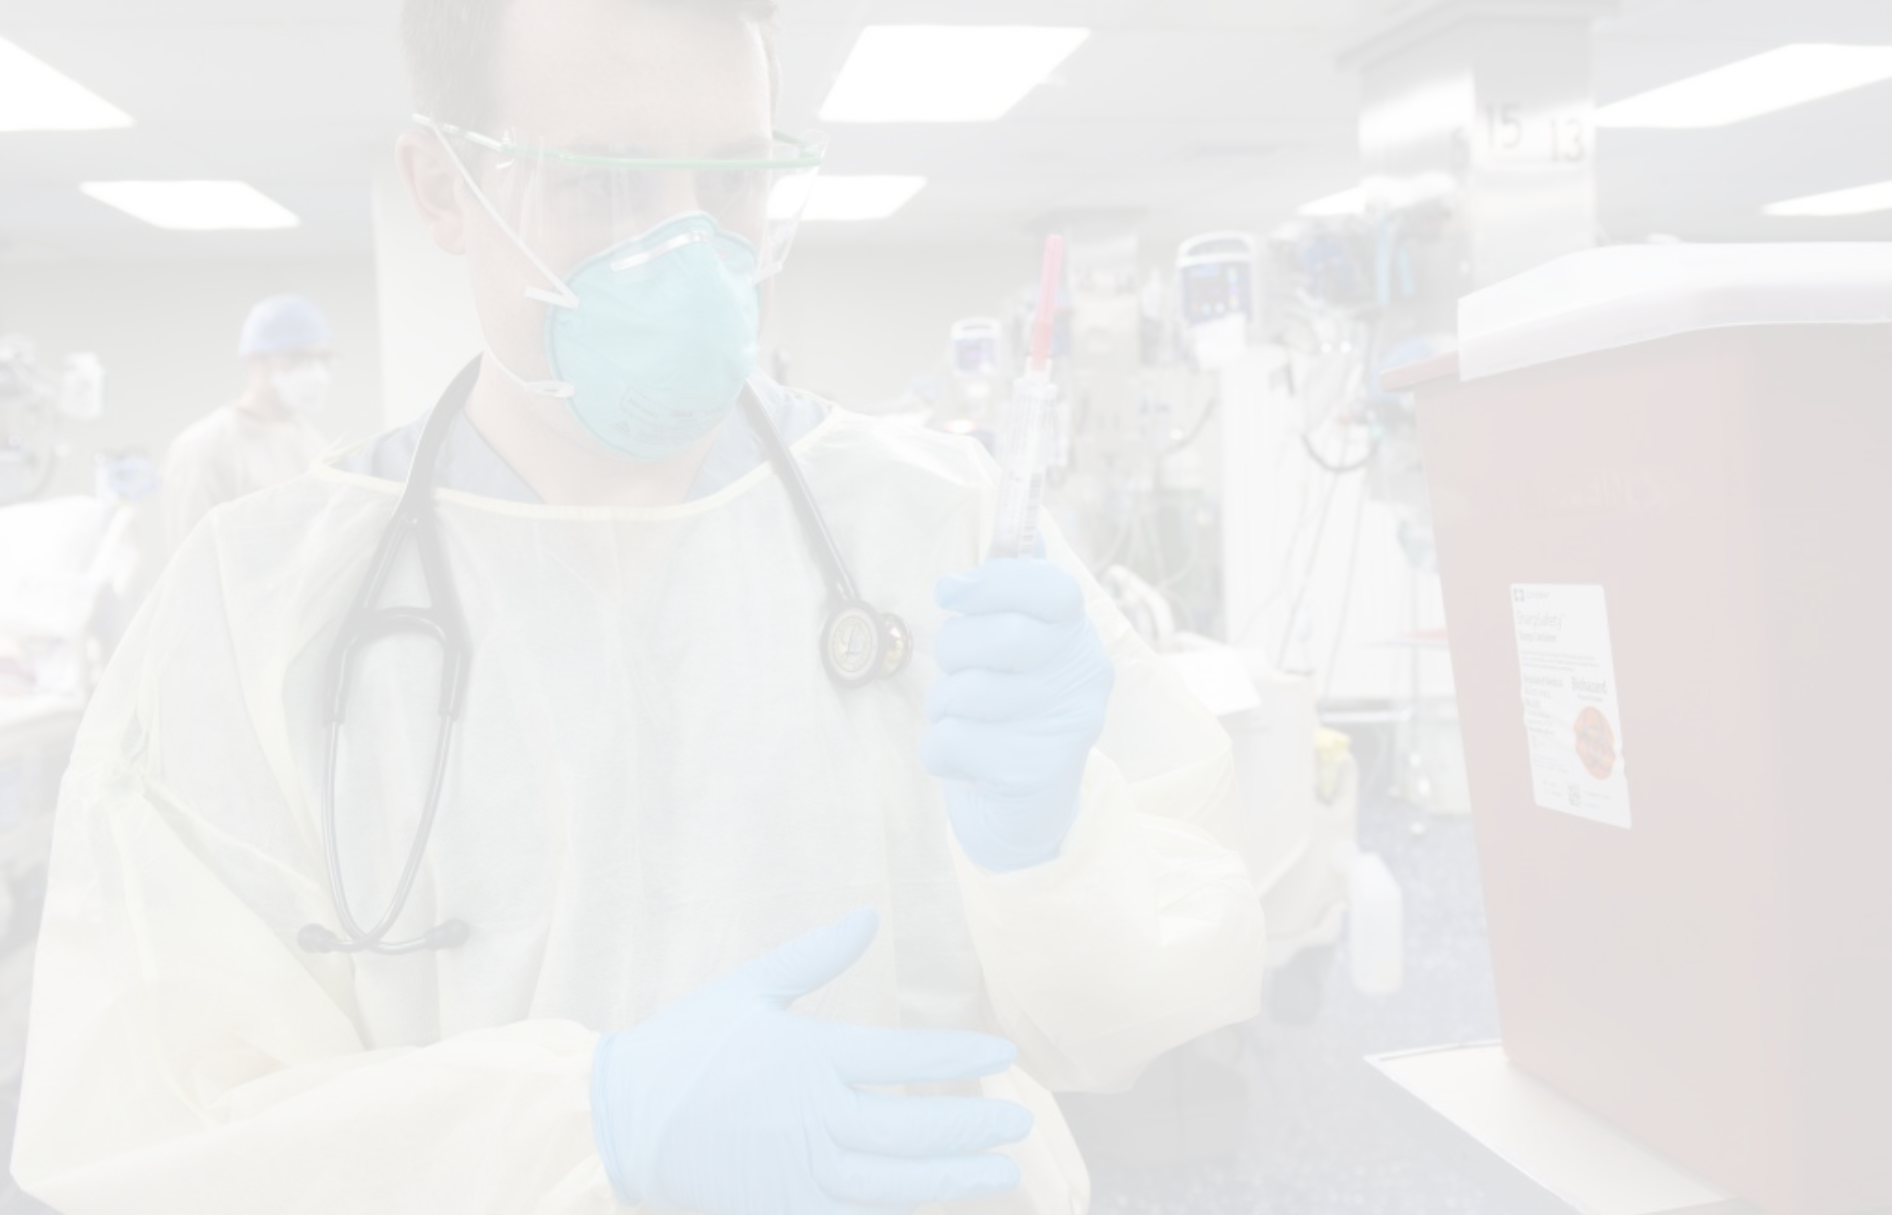
Resources
Contacts
ICB Infection Prevention and Control Team – somicb.infectionpreventioncontrolteam@nhs.net
UKHSA South West Health Protection Team – swhpt@ukhsa.gov.uk

