Slide 1
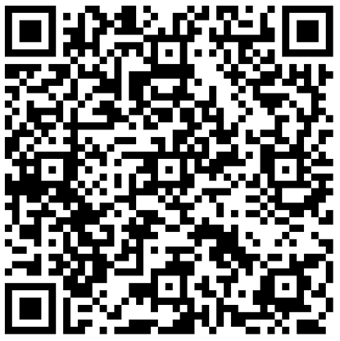
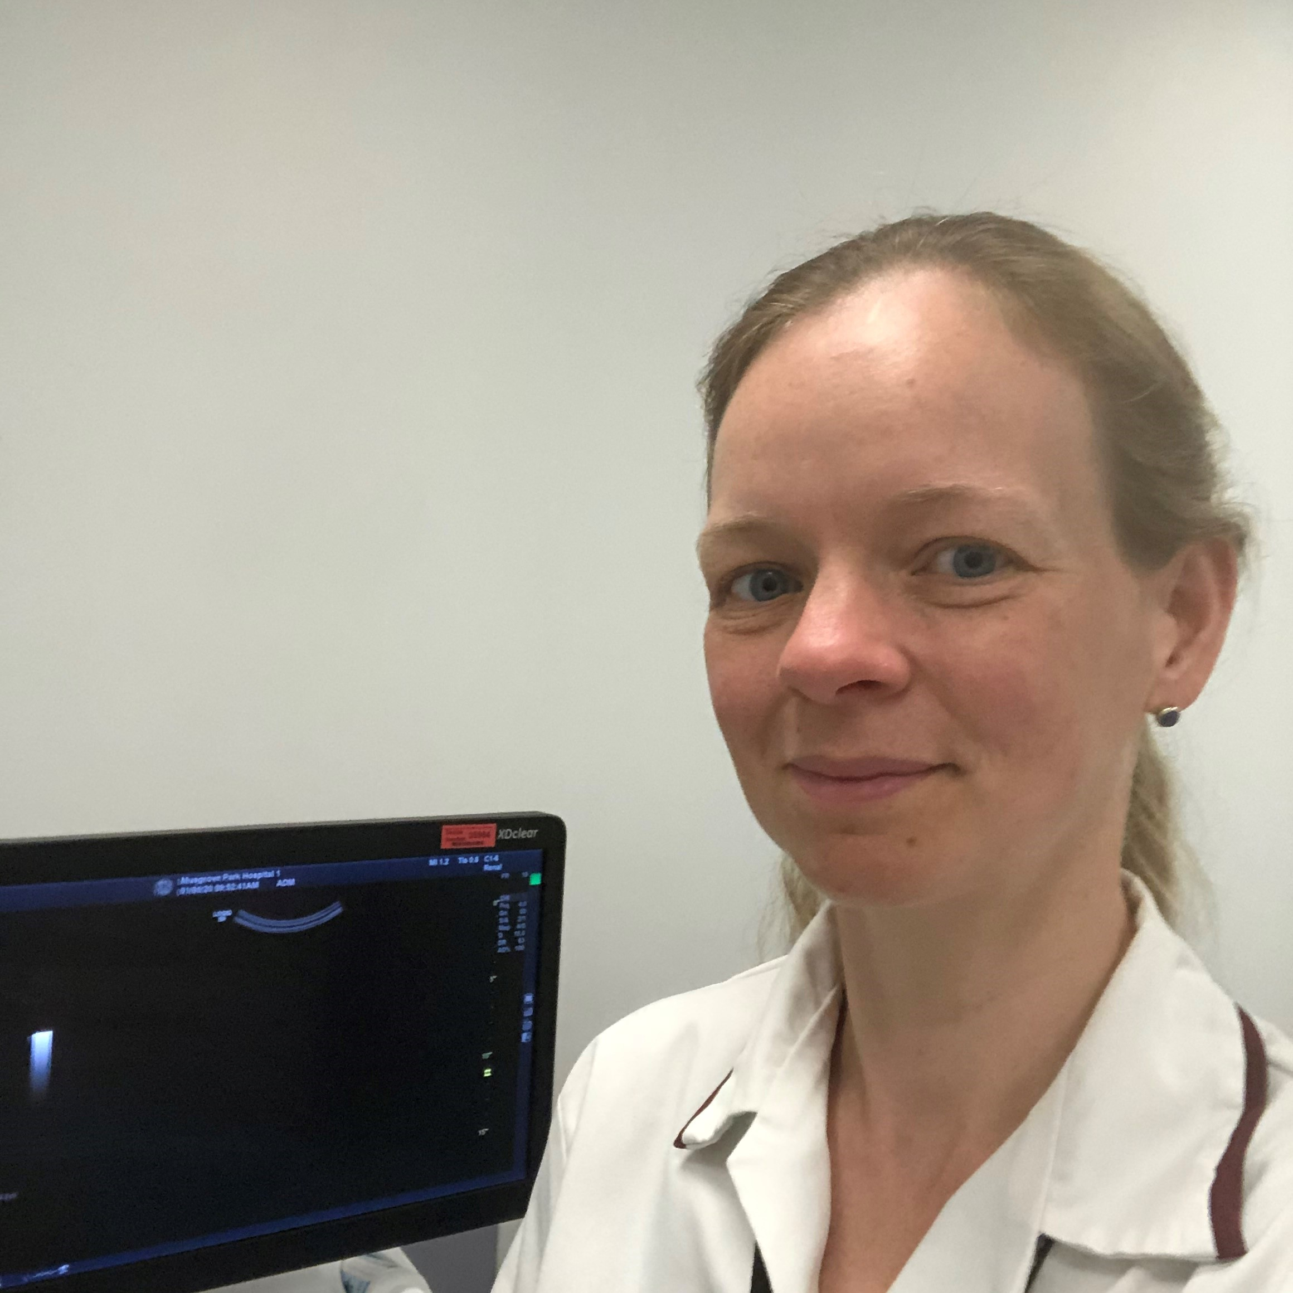
Improving Radiology Report Communication
Please help the team to get this right by completing a short online survey.
Primary Care
Acute
A&E
Community
We need 6 minutes of your time
Radiology
Help to shape the way our Radiology reports are communicated
Our Radiology department is proposing to introduce a new digital-based critical results notification (CRN) system.
The team needs your input to ensure the new system works for you and, vitally, for our patients. We have the unique opportunity to shape it to meet our needs.
The proposed software solution should mean that a ‘finding’ cannot be lost or left undealt with. It has the potential to provide significant benefits, including improved accuracy and completeness of communication, improved efficiency and productivity, as well as enhanced patient safety.
The project is being led by Alice Bevan, a Registered Nurse by profession, who currently works as a Sonographer based at Musgrove Park Hospital.
Alice is undertaking this project as part of the Chief Nurse Research Fellowship Scheme, so if you have any questions or would like to know more about the project, please feel free to contact her on Alice.Bevan@SomersetFT.nhs.uk.

