Slide 1
Somerset System Flu Group 26th August 2020
Version 2.0
Influenza Immunisation 2020
Guidance, Options and Solutions for Primary Care
Please note due to the fluid nature of Covid-19 Guidance, this is our current position
It is anticipated we will update this every two week or in accordance with national guidance being updated or released
For the latest version please visit the CCG website

Slide 2
2020 Flu Programme
The 2020 second flu letter has now been released the ambitions that were announced in the media fit with those advised by NHS E.
Who will be offered the flu vaccine?
people who were required to shield from coronavirus and anyone they live with
at risk Groups, with some medical conditions including diabetes, COPD, heart failure and asthma - this years ambition targets have gone up from 55% in 2019 to 75% for 2020
pregnant women
pre-school children over the age of two
all primary school children, as last year, and, for the first time, Year 7 pupils
initially all people over 65, before the programme is extended to the over-50s
health and care staff (and other carers group)
The full list is available in the CMO’s second flu letter linked above.
Training needs to be offered in line with the guidance
Please note that, correct as of this date, healthy 50-64 year olds are not currently an eligible cohort for the NHS flu immunisation programme in 2020/21, and as such should not be prioritised over the confirmed eligible cohorts. Due to their ineligibility a payment mechanism via CQRS is not available for healthy 50-64 year olds and practices will not currently be funded for this group. This will be reviewed in November.

Slide 3
FAQ’s for Clinics
What PPE Should I use?
PPE guidance was updated on the 21st August, and now states the following: “In some clinical outpatient settings such as vaccination/injection clinics, where contact with individuals is minimal. The need for single use PPE items for each encounter, for example, gloves and aprons is not necessary .” “Staff administering vaccinations / injections must apply hand hygiene between patients and wear a sessional facemask.”
IPC Guidance can be found here
Should Patients just “turn up” to the surgery?
No, they should be screened to ensure they don’t have active symptoms
No, There should be a thoughtful other consideration to workflow and capacity taking place in the practice / pharmacy the flow of patients through the clinic / practice needs to be carefully risk assessed to minimise the risk of infection.
We would recommend that vaccinations or clinics would be planned.
What do I need to communicate to my patients prior to attending?
Patients will need to ensure that they wear face coverings when they attend.
They need to attend alone as there is limited attendance as far as is reasonably practicable.
Patients should be informed not to attend if they are showing symptoms of Covid-19 or if they are isolating due to contact with potential / actual Covid-19 cases.

Slide 4
Ideas that others are considering
Please note CQC recommendations are clear about the requirements if undertaking immunisation outside a health care environment and can be found here
It is likely that quite a few of these ideas may not be suitable within existing resource, most practices as far as we are aware are planning in practice solutions and having weekend clinics / special week clinics with consideration of patient flow.
Drive through (practice car park) systems
Drive through (using local village hall or sporting venue (eg rugby club)
Care home vaccinations in single visit (possibly care home staff too) and consider if weather good outdoor clinic
Using bar codes to help identify patients (EMIS computer system)
Working together as a Primary Care Network – and running clinics across PCN in collaboration
Extension of weekend clinics
Offering vaccines for those “at risk” when they present for other appointments.
For all of the above the following factors would need tot be considered and risk assessed:
Patient Identification and Documentation
Cold chain management
Cleaning
Waste Removal
Here is a helpful links on barcode solutions that could can help.

Slide 5
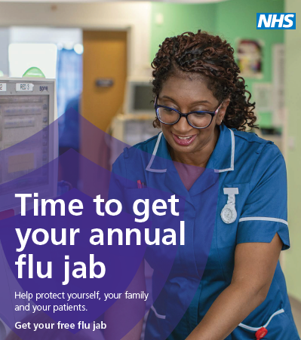
For any solution please consider
Spreading out when your flu clinics are.
Giving more time per patient to be vaccinated
Implementing one way systems to prevent patient cross-over in corridors
Revise your messaging to patients, keeping it clear and concise outlining that it will be different this year identifying how.
Give patients a time specific slot to attend
Keeping to timings in clinics to prevent a back up of patients.
What PPE to wear when administering vaccine and when to replace this.
How to manage and protect shielded patients.
Reducing contacts to vulnerable patients – could the vaccine be offered to vulnerable patients during other routine appointments?
Can you improve your staff uptake rate, are your front line staff vaccinated and is this reported onto Immform?

Slide 6
Worked Example from a Practice
Previously we have run off site children’s clinics but we didn’t get a huge uptake,
This year we are looking to offer offsite clinics to help with one way flow and capacity issues.
We intend to have blocks of appointments every 15 mins with 9 patients in each slot. So at 09:00 9 patients arrive, at 09.15 the next 9 etc. We will have at least three and more likely 4 clinicians vaccinating. The hall we are renting has three doors so very easy to keep people distanced and to keep them moving through given the staggering of the appointments.
We are planning on having an admin person checking patients in and advising them to prepare (take off coat, roll up sleeve etc). We should be able to update the records there and then.
We are trying to work out how best to set the appointments up on EMIS, once that is done we will be texting patients to advise them they can book.
For those without mobiles we will telephone we have arranged for a receptionist or admin person to stay a little later for several evenings so we can ring people at home. We have found in the past that ringing during the day often does not catch people in so the hope is after 6pm most people should be home.
We will also ring not just those who don’t have mobiles but also anyone not yet booked at that time.
Here is a worked example for some of the factors that a Practice in Somerset has considered when drawing up plans for a clinic off site.
We are aware of other practices considering the use of church halls and a couple of sites are looking at drive through options. If you would like to talk about these more please contact: james.warren5@nhs.net

Slide 7
Influenza Vaccination Supply
We know this year more than previous years early supply of vaccination will be critical to a successful campaign and immunising the right group early.
We appreciate that you will have already ordered your vaccine stock for your expected population needs, the purpose of the pre season enquiry as to stock levels.
The department of health have advised that they will be able to release stock that can be drawn down in a timely fashion. This information is expected to be released in September and when we hear more on this we will of course update the guidance with the process and the links that are required.

Slide 8
Social Care
Social Care implications for flu vaccine?
The eligible groups have been expanded this year to include those health and social care workers, such as Personal Assistants, employed through Direct Payment and/or Personal Health Budgets to deliver domiciliary care to patients and service users.
Across Somerset we have a diverse offering to support individuals and promote independence. Social care is delivered in residential settings, but also in supported living and also in the community with domiciliary staff and micro-providers.
There are approximately 18,000 staff working to provide social care across Somerset and many of these staff would not under normal circumstances be included within the high priority groups.
Given the significant impact of Covid on those vulnerable residents it is vital that these staff are captured within this years vaccination programme.

Slide 9
Learning Disabilities and Flu
People with a learning disability are at greater risk of developing serious illness and:
can be more susceptible to the effects of flu
at increased risk of developing complications such as bronchitis or pneumonia
The most frequent causes of death amongst people with learning disabilities are diseases of the respiratory system (19%):
the most frequently cited conditions on death certificates (part 1) are pneumonia (25%) and aspiration pneumonia (16%)
From 2014 people with learning disabilities have been eligible to have a free flu vaccination however there has not been an appreciable rise in numbers receiving this.
GP surgeries should give a clear message that people with learning disabilities, their family carers and paid supports are entitled to free flu vaccinations

Slide 10
Reasonable Adjustments
There is a legal obligation to put reasonable adjustments in place to ensure equal access to health services for people with disabilities.
Avoidance – anxiety about needles (support from LD Specialist Team for desensitisation), demonstration of vaccination prior to appointment, nasal spray alternative
Accessible Information:
Easy Read – leaflets and posters, flu vaccination invitation letter, story books
Phone call or large print invitation for sight impaired, videos
Clear speech and use of simple words
Experience:
Environment – Quiet/ sensory friendly place to wait/private room, wheelchair access
Physical sensitivity/pain - numbing skin, explain actions before and during procedure
Time – more time with doctor or nurse, double appointment, at best time of day for patient (energy levels, routine, avoid practice/venue peak-times)
The list of reasonable adjustments is not exhaustive, there are many more simple acts that can be done to support someone.
Resources:
Somerset LeDeR Newsletter (June 2019) – Reasonable Adjustment Article (Easy Read)
NHS England – Reasonable Adjustments
NDTi – Reasonable Adjustment Guidance (September 2019) & Flu Injection resource

Slide 11
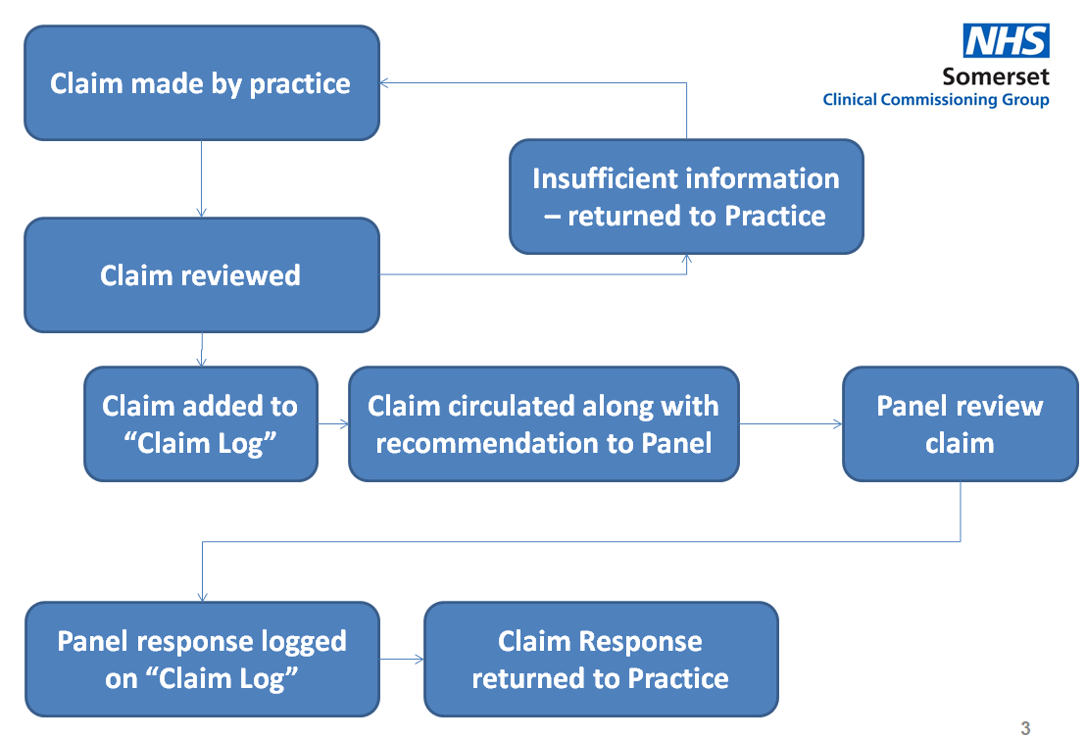
Additional Cost Claims
We accept that clinics are going to need to be different this year and especially to help encourage large scale clinics we are looking at how additional costs incurred by practices can be reviewed and approved by the CCG.
We are currently mapping out the a process and will share this with you as soon as we can but we are keen for you to develop your ideas

Slide 12
Carers and household members
The national guidance provides advise:
household contacts of those on the NHS Shielded Patient List, or of immunocompromised individuals, specifically individuals who expect to share living accommodation with a shielded patient on most days over the winter and therefore for whom continuing close contact is unavoidable
those who are in receipt of a carer’s allowance, or who are the main carer of an older or disabled person whose welfare may be at risk if the carer falls ill
As well as health and social care workers highlighted elsewhere.
Interpretation
We recognise that those that on the formal NHS Shielded List, that that shielded voluntarily, those that are immunocomprised has varied as are those who stay in the house with the patient. Equally many main carers (there may be more than one) looking after older or disabled people whose welfare may be at risk.
Approach
The principal is similar to health care and social care workers to protect those that are more vulnerable and those caring for them. It is accepted that there will be grey areas - and in principle if a carer or household member appears to meet the guidance and direction they should be ideally immunised

Slide 13
We hope that you have found these tips helpful, and can be used to aid the development of your clinics.
We aspire to continue these communications to practices over the coming months in preparation for the flu season.
Therefore, If you would like to add anything such as top tips of your own to share with your fellow practices then please email me on james.warren5@nhs.net
Finally we would be keen to learn from your experiences as this may be helpful if and when a COVID vaccine is available.

